Slide 1

fuse™ digital visualizer
See the world… here and now

Slide 2
Teacher feedback
The reasons why…

Slide 3
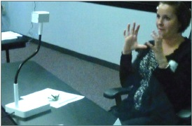
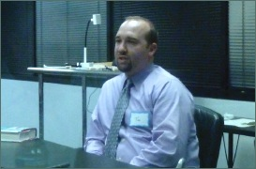
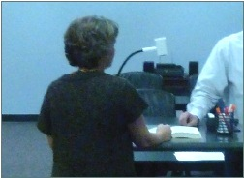
What teachers are telling us…
“I’m always looking for new ways to reach and engage my students”
“It has to be easy to learn and use.”
“I need a better means for distance learning initiatives”
Notes:
Slider Zoom on from App
Turn on Light from App
Reset on App
Marque Zoom to 2nd image

Slide 4
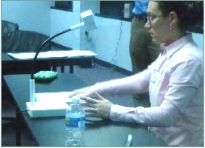
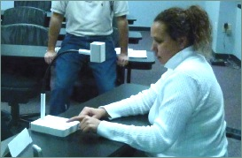
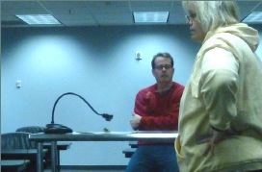
What teachers told us about visualizers …
“I can use this to share, or even scan student work.”
“This is great to capture student projects.”
“I would annotate over live demonstrations and print out answer keys.”
Notes:
Light on device
AF on device
Zoom marque from Icon Strip for each photo
Lock image on icon strip
highlight teacher comments
Unlock in App
Display highlights

Slide 5
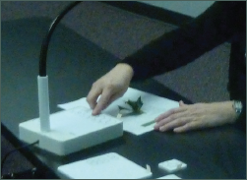

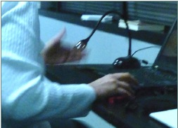
What teachers told us about visualizers…
“The big buttons are easy to find. I like that they are my finger size.”
“This is easier to align the subject… I like knowing the power is on.”
“I’d like to use more technology, but I don’t have a lot of room on my desk to store these sort of things.”
Notes:
Image capture on device
Paste into PPT
Virtual ink in ppt

Slide 6
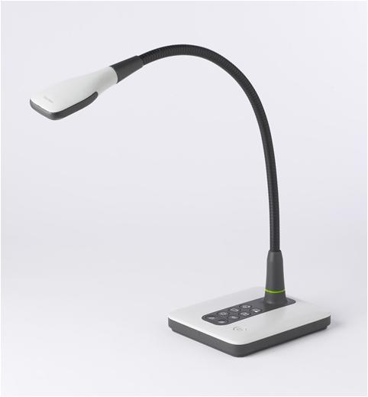

Slide 7

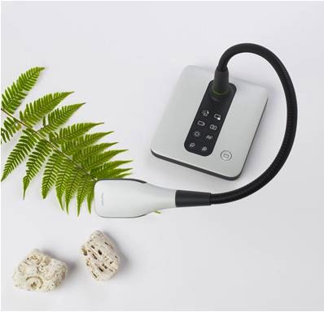
Multi-functional tool
use case
Document camera
Show and annotate over live demonstrations
  Cables direct to computer so annotations are automatic
What is the classroom application?
  Display student work
    Builds confidence
    Reinforce strong performance
  Assessment
    Display answer keys
    Save valuable classroom time
  Work problems out of prepared lessons
    Flexibility to adapt to students’ needs
  Collaborative work
  Print documents at parent conferences
Notes:
Reset all defaults

Slide 8
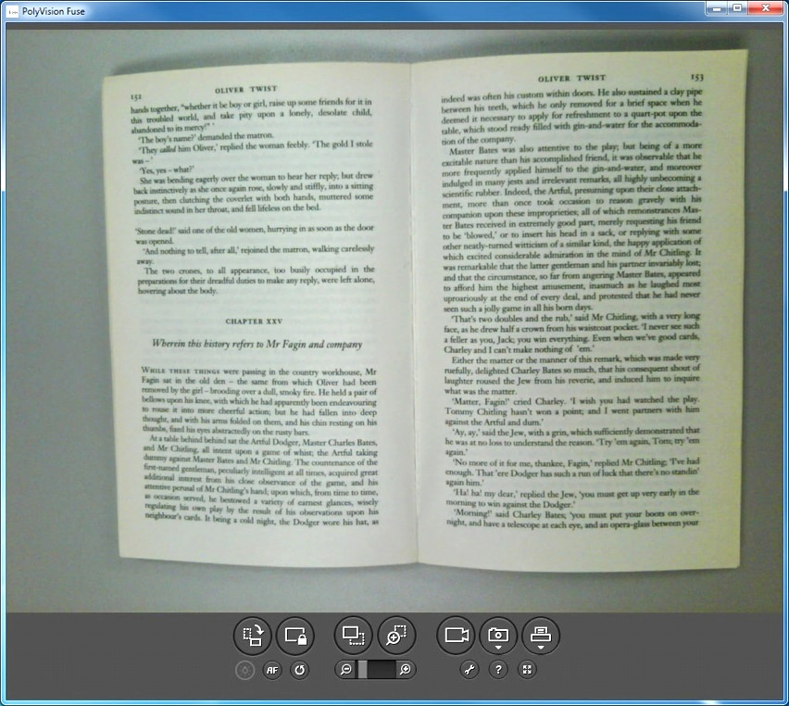
Multi-functional tool
use case
Notes:
Reset all defaults

Slide 9
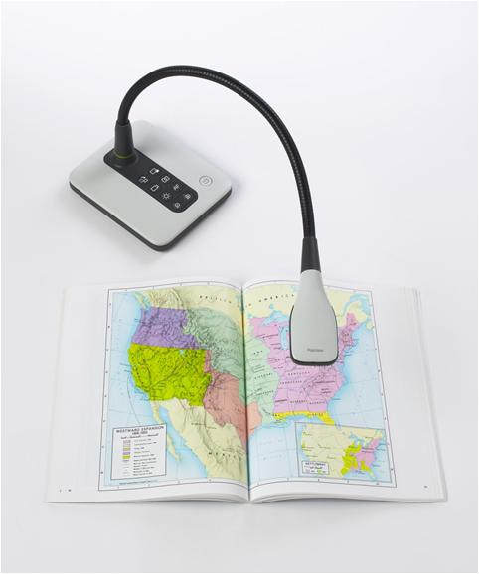
Multi-functional tool
use case
Scanner
Prints and saves
Editing software
Eliminates a costly second component in the classroom
What is the classroom application?
  Reinforce concepts and key teaching points
  Bring hardcopies of existing documents into class presentations
  Hold digital portfolios of student and class work
Notes:
Reset all defaults

Slide 10
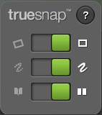
TrueSnap™ technology
use case
Auto-editing for documents, book pages and binders
Re-align
Re-color
Unbind
Notes:
Auto-editing for documents, book pages and binders
For the Image saving and printing functions
Saves time, frustration and improves value of the visualizer
Re-align
Edge detection technology
Saves time and produces a perfectly centered image
Re-color
Using a limited pallet of standard whiteboard markers for a more legible document
Best for documents and books, less so for 3D subjects
Unbind
Takes creases and binders out of books for legibility

Slide 11
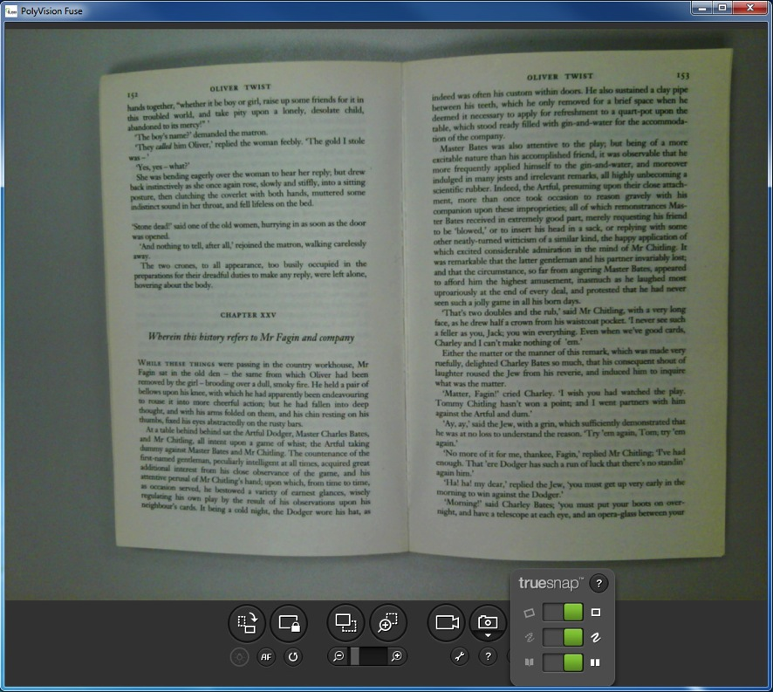
Multi-functional tool
use case
Notes:
Reset all defaults

Slide 12
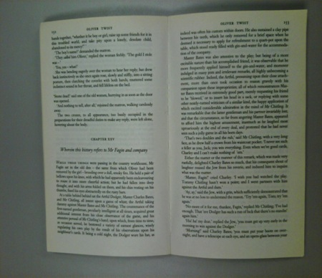
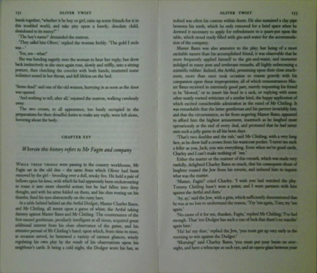
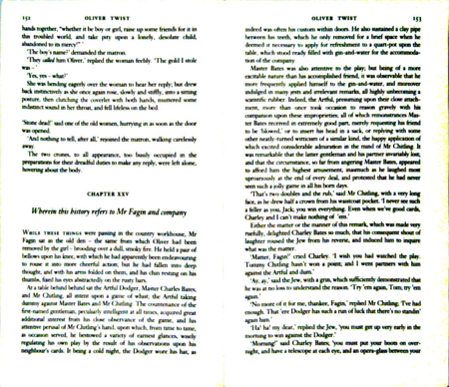
Multi-functional tool
use case
Before
After 1 : Re-aligned
After 2 : Re-aligned,
Re-colored, Unbound
Notes:
Reset all defaults

Slide 13
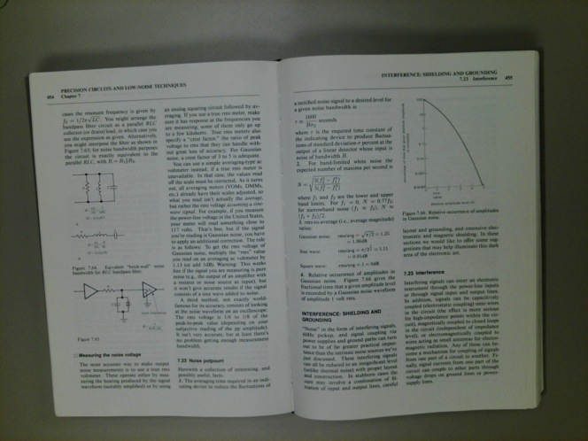
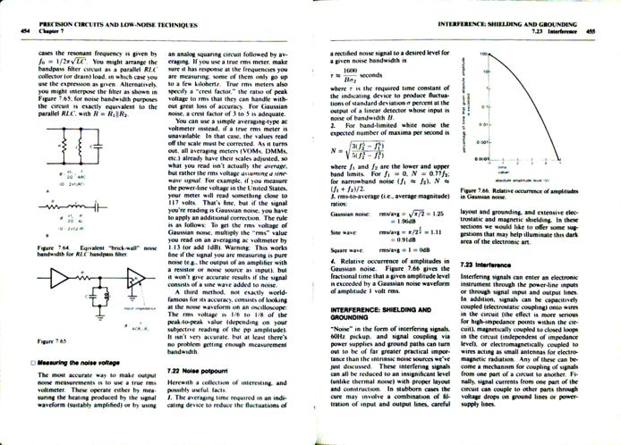
Multi-functional tool
use case
Before
After 2:
Re-aligned, Re-colored, Unbound
Notes:
Reset all defaults

Slide 14
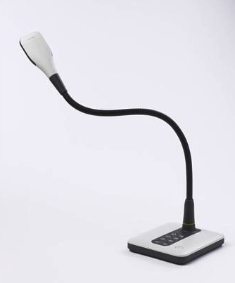
Multi-functional tool
use case
Web camera
Video at 30 frames per second (fps)
Save videos on the computer
What is the classroom application?
  Using Skype
    It brings the teacher to the student in distance learning
  Live feeds to collaborate and question
    Collaborate across districts, regions and continents at no cost
    Virtual field trips
  Save live demonstrations for students to access away from class
  Science projects
  Record videos

Slide 15
Key design elements
What you can see
details
Feature | Benefit
Aesthetic and lightweight | Easy to set-up, move and reset Preferred design (7 out of 10 teachers)
3.2 MP camera | Hi def – 1080P output Bright, vivid colors
Compact, anti-tip base | Easily fits within the tight confines of a teacher’s desk Weighted for stability
Easy Grip inserts on camera head | Easy to center and zoom on subject
Flexible neck with no memory | Camera holds in place
LED light | Supplemental light source when needed

Slide 16
Key design elements
What you can look for
details
Feature | Benefit
fuseTM software | Intuitive user interface increases adoption
Large, single command buttons | Easy to find , easy to operate Placed for optimal use
Built-in alignment indicators Square design in head and base | Assists in centering and squaring documents
Recessed USB under base of camera | The device and students in the room are protected from damage
USB power | No additional power cable
6mm glass optics | Durable, scratch resistant
Large capture area (17” x 11”) | Can capture a full and open binder Camera captures large objects

Slide 17
Key Design Elements
What you can’t see
details
Feature | Benefit
Three interface options - device, window application or icon strip | Freedom to operate No remote control and no batteries
Concise functionality | Simplicity of operation Most valuable functions without being overwhelming Increase adoption
Images and videos save into computer | Familiarity with PolyVision Driver increases use - No storage constraints
Video rate: up to 30fps | Best for rapid moving images
Sticky features with Default Reset | Images manipulations are held until intentionally reset by user
Tactile feedback on functional buttons | Device buttons provide a noticeable feel for the user

Slide 18
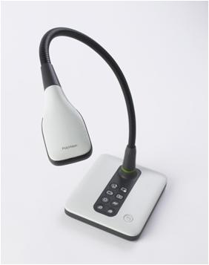
Warranty
details
3 years from date of shipment from the factory for all manufacturing defects
For repair or replacement by PolyVision, at PolyVision’s discretion

Slide 19

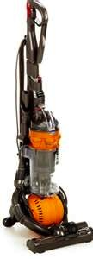

Recap
summary
The three things to remember
Multi-functional tool to share and collaborate
Optimal design and user interface
Crystal clear image, hi-def camera
Notes:
Reset all defaults

Slide 20
Thank you from PolyVision
Notes:
Concluding slide

